Slide 1
Project management in R
How to write understandable and reproduceable code

Slide 2
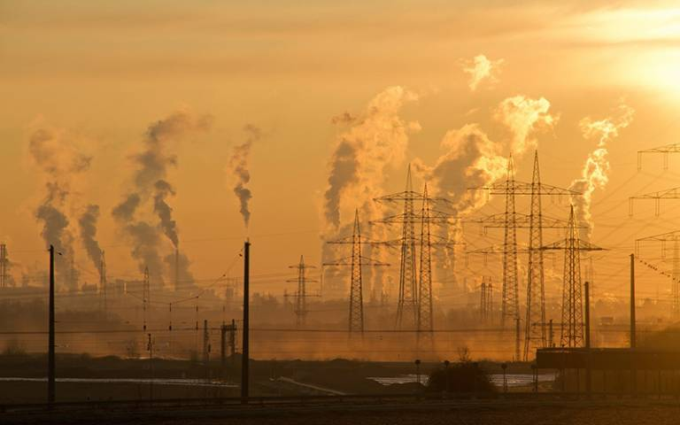
Ecological crisis

Slide 3
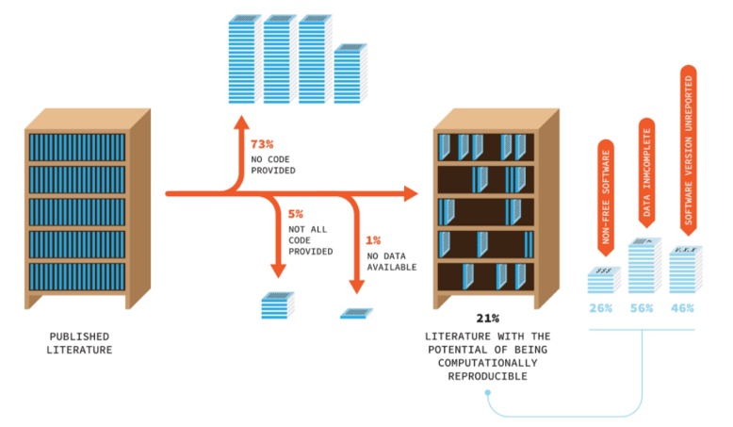
Low code availability crisis in ecological research
For most studies (73 %) no code provided
Code is not always findable
computational reproducibility ranged from 18% to 80%, even when data and code are provided
More journals require or encourage authors to make the code publicly available
https://doi.org/10.1371/journal.pbio.3000763
Notes:
Percentages estimated from a review of articles (n = 346) published in 14 ecological journals with mandatory or encouraged code-sharing policies, and, thus, these percentages likely overestimate the true percentage of computationally reproducible literature. Furthermore, because much code (and data) is published in nonpermanent repositories (see section “Findability, accessibility, and reusability”), long-term computational reproducibility is likely substantially lower. *Rough estimate based on the subset of articles published in 2018–2019. Data to reproduce this figure are available at findable (e.g. published in a repository on Github and permanently stored on Zenodo)

Slide 4
Project management
Projects in R
What makes code reproduceable?
GitHub (see www.github.com/MaartenPostuma/exampleProject)

Slide 5
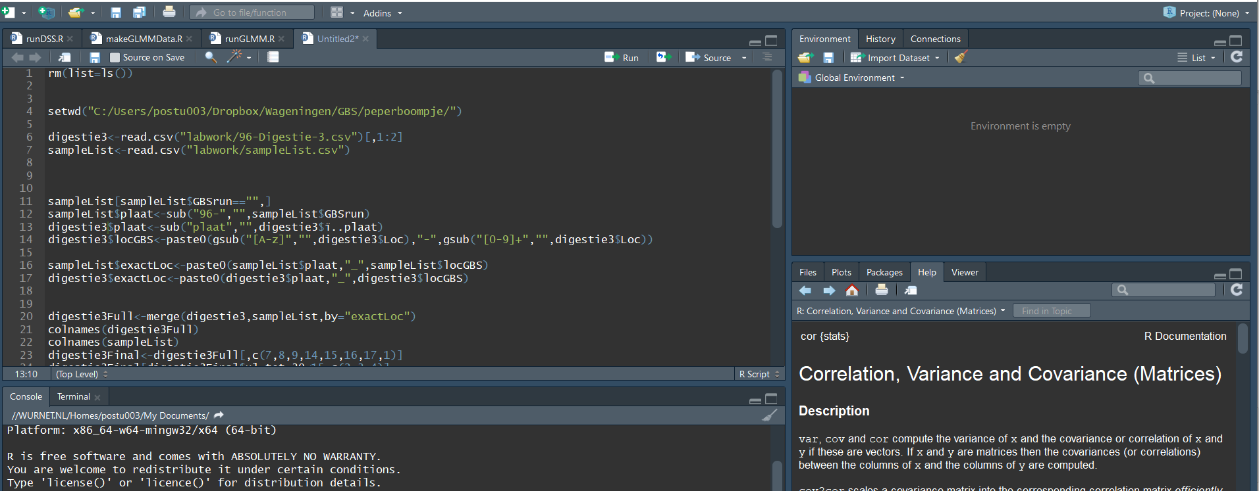
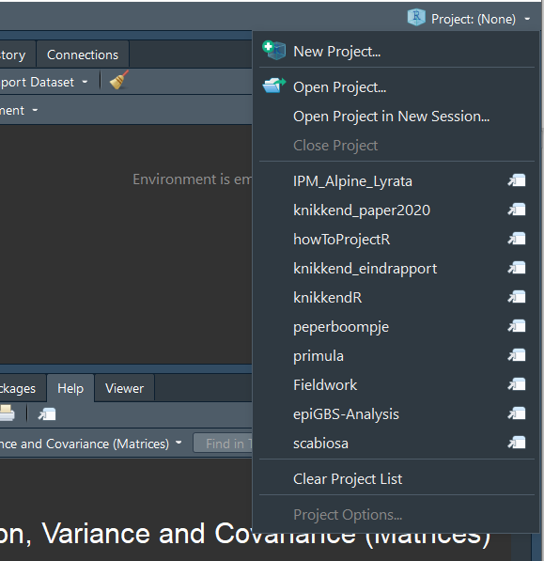
My favourite Rstudio button!

Slide 6
What is an R project?
It is similar to setwd()
Allows for the use of a Rprofile
And you do not have to use setwd() in every script!

Slide 7
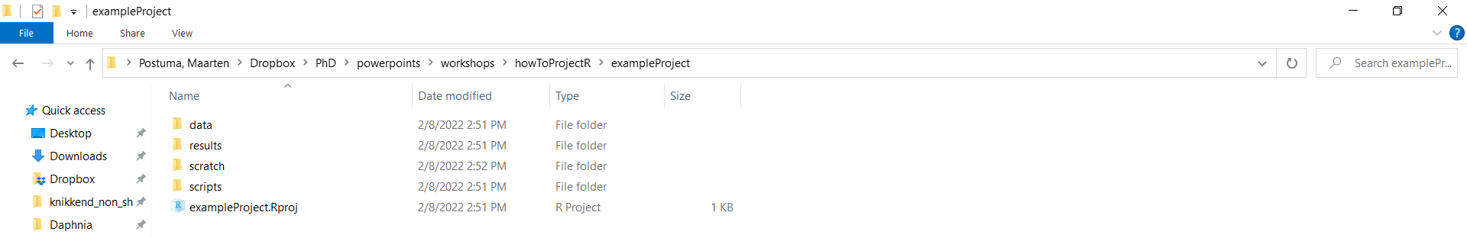
How to manage your project
Data
Raw data
“cleaned” data
Scripts
All of the scripts
Results
Tables
Figures
Scratch
Temporary files
Always use the same directory structure.
In this way scripts always work!
Use relative paths:
read.csv(“data/dataFile.csv”)
Instead of (“C:/maartenp/place/where/I/stored/my/data/real/data/nottheOlddata/”)

Slide 8
Stages of data analysis
Exploration:
How is my data structured?
What do I want to do with my analysis?
Data wrangling
How do I need change the raw data to fit my needs?
Analysis
Producing the prettiest plots
Quest for the best test

Slide 9
How to go from exploration to analysis
Rawdata > input data for analysis
What do I need to do to get from the raw data to a format I can use for plots and statistical analysis
Seperate script!
Store data in the data directory!

Slide 10
Making Figures
Seperate script for each Figure + Table
With statistics belong to each figure or table included in the script
Easy to find what was done to generate specific figures and analysis

Slide 11
Writing Code
Annotation!
Even if it seems clear!
You cannot annotate too much
Name variables
If you need to use something > 3 times store it as a variable
Generalize
If you make a for loop over 21 locations use 1:length(unique(locations)) instead of 1:21
Write output data.frames
Outputting data files using write.csv() or write.table()
Save plots using ggsave() or png(“results/Figures/plot.png”); plot(x~y); dev.off()

Slide 12
Let’s do some example coding

Slide 13
Going above and beyond!
R markdown
Output your code / figures in PDF, HTML or even Word!
See examples

